Slide 1
Roxburgh Entertainment Centre
Central Otago District Council

Slide 2
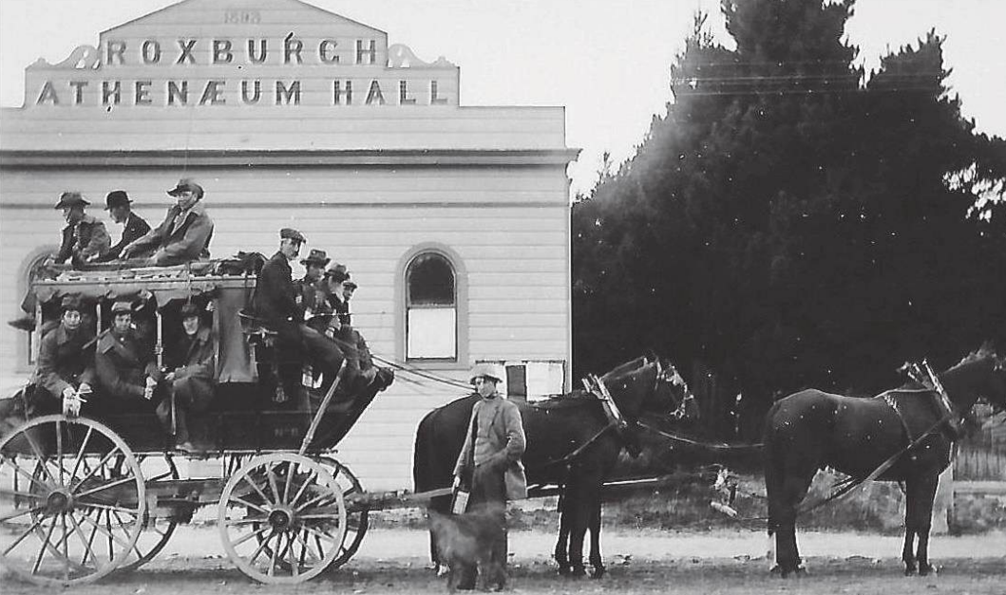
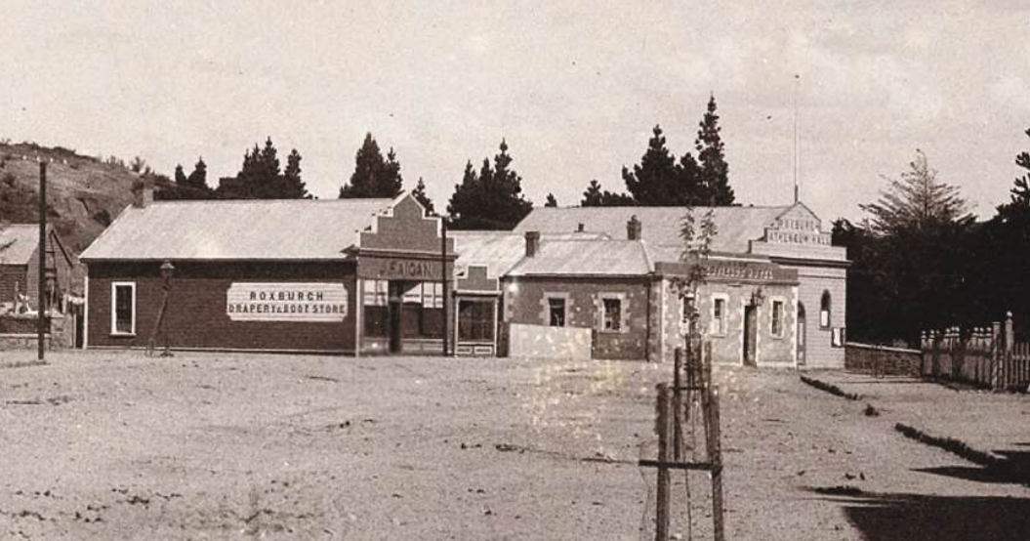
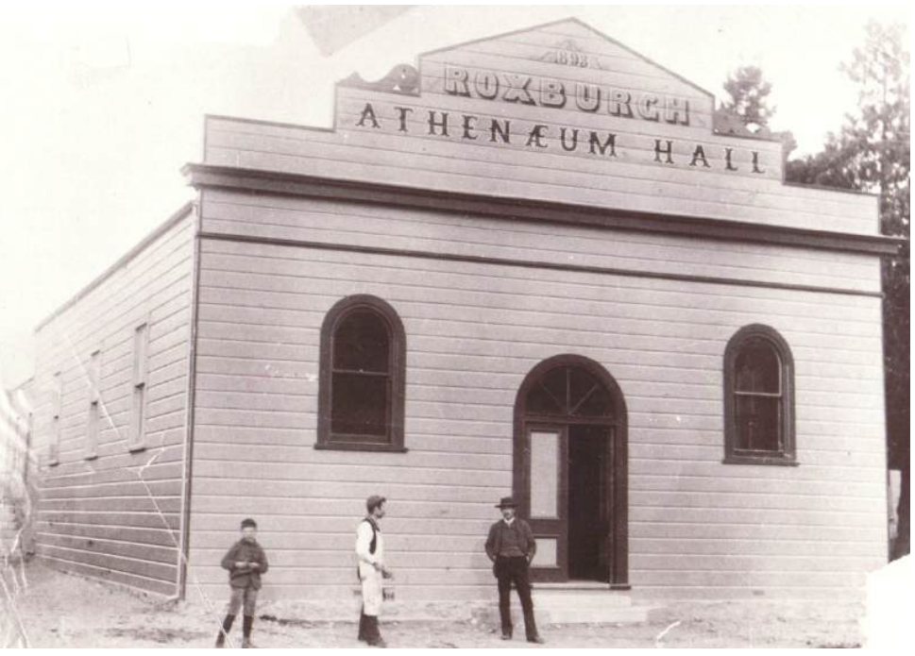
Hall, Theatre and Cinema
Beginnings
The Roxburgh Hall begun construction in 1875.

Slide 3
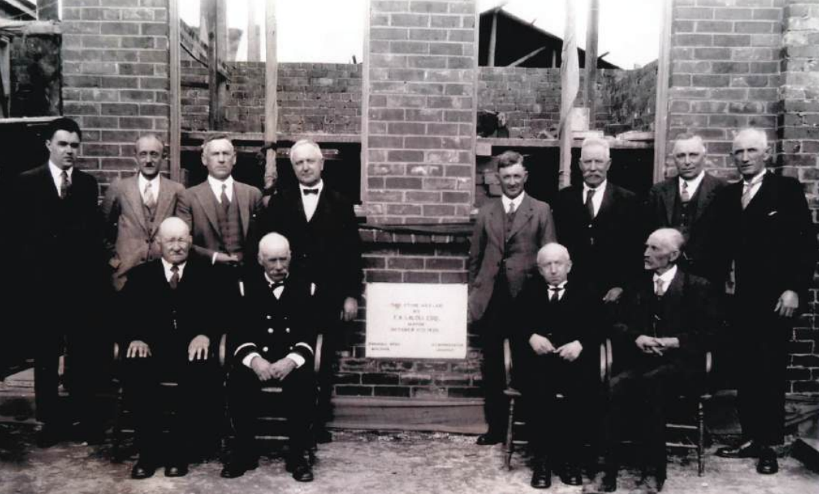
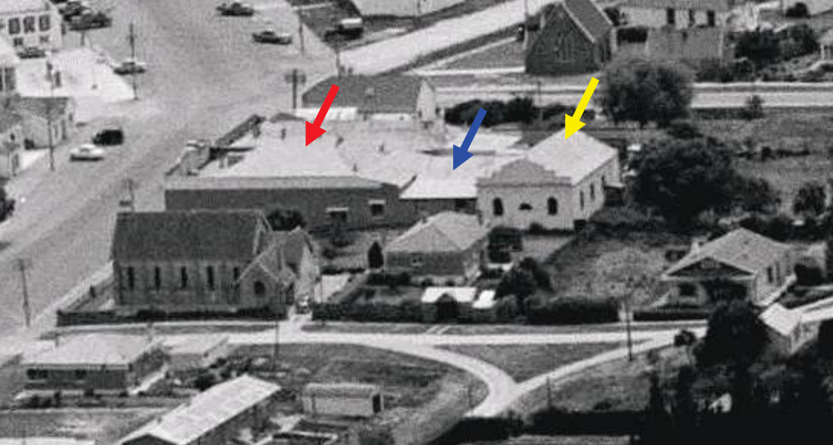
Hall, Theatre and Cinema
Beginnings
In 1918 the Hall was vested to the Borough Council
In 1926 the Borough Council invested in a projection machine.
Hall moved and the new building was reported open in the Otago Witness in March 1931.
Renovations were undertaken over the decades to become the Roxburgh Entertainment Centre.

Slide 4
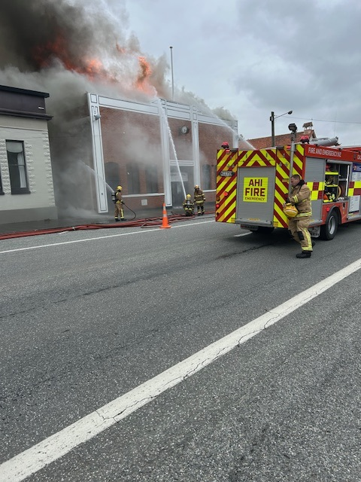
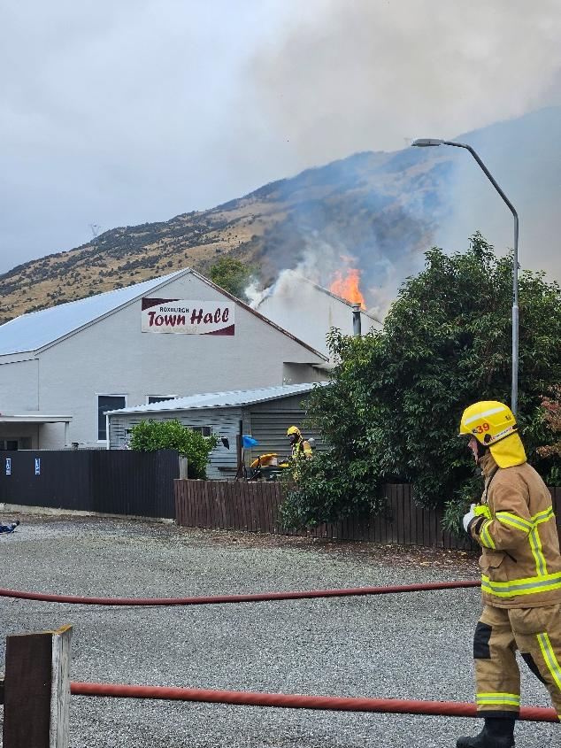
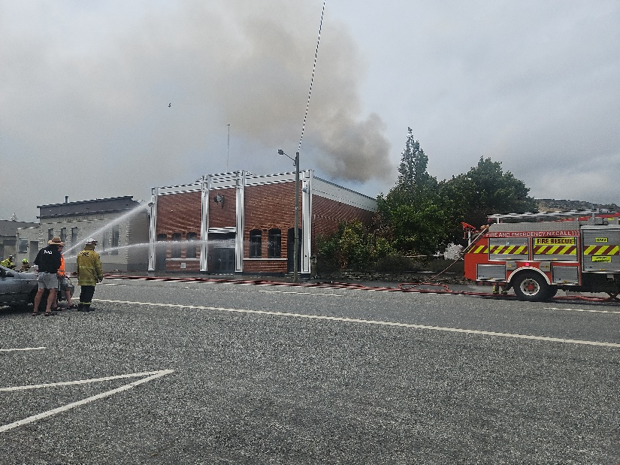
Fire Disaster
Thursday 6th February 2025

Slide 5
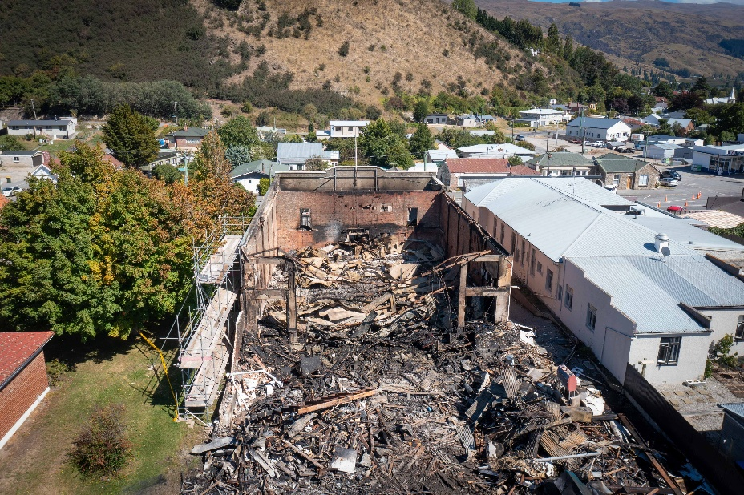
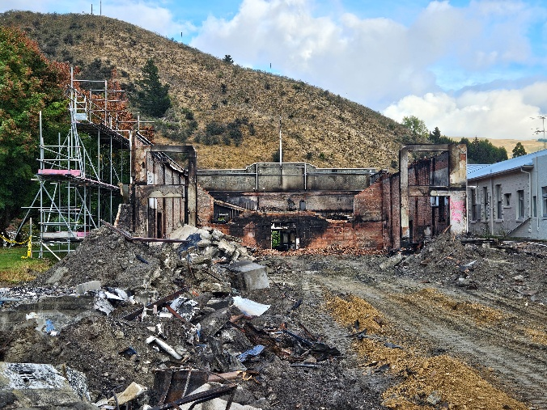
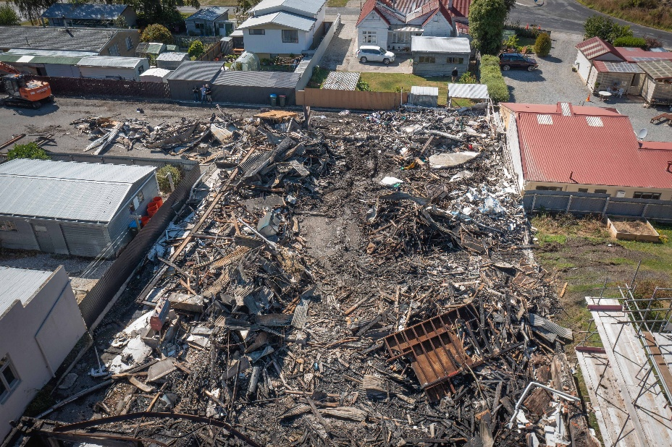
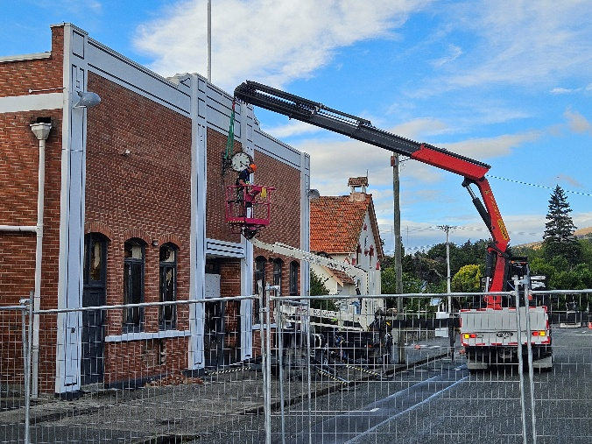
Fire aftermath
Post fire destruction, façade investigated.

Slide 6
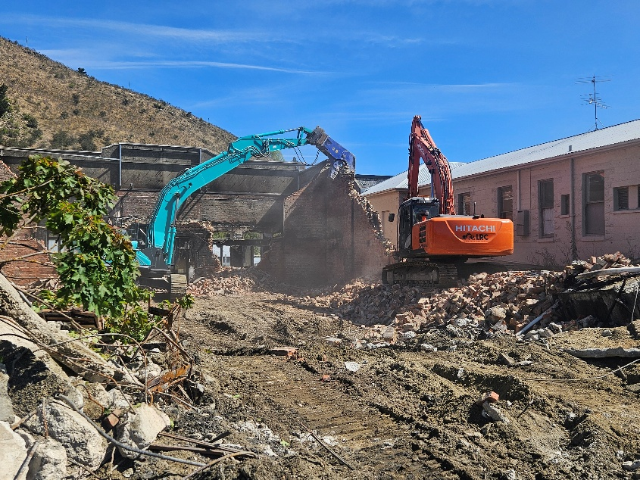
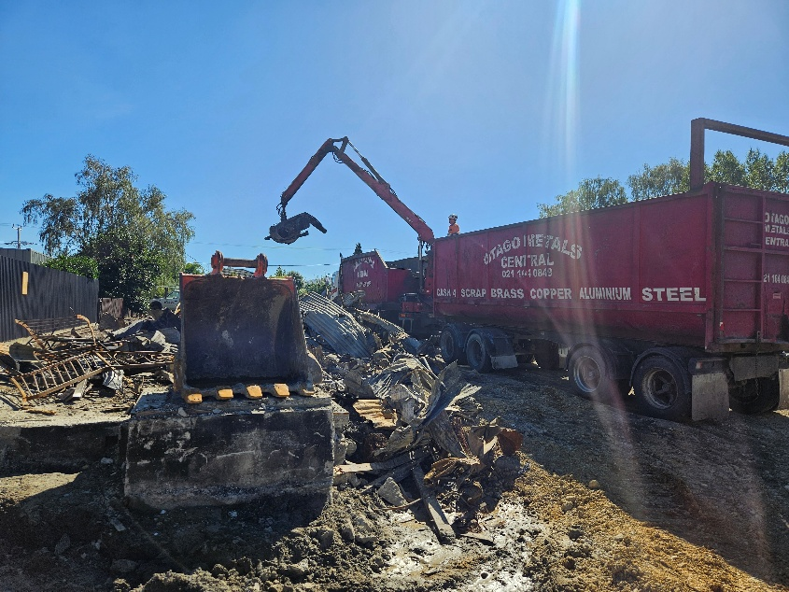
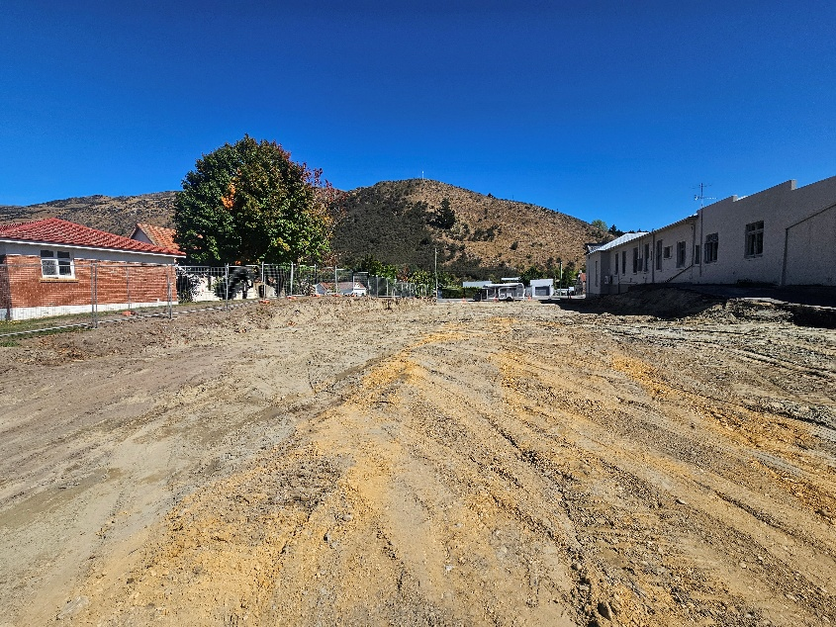
Site cleared and free of asbestos
Façade removal
Site clearance, metal removal

Slide 7
Immediate Considerations
Asbestos: no complications additional testing and removal, clearance cert has been issued.
Historical ramifications: Because the site is pre 1900’s it is deemed a historical site and all care needs to be taken. Engaged Origin Consultants who have experience in this area and are liaising with Heritage NZ for an archaeological authority to continue site works.
Dust mitigations: Lake Roxburgh Contracting are investigating options:
K-line with timer estimated cost $2750
Gravel (potential re-use in car park or similar)

Slide 8
Remediation Costs
Costs incurred to date
Supplier | Description | Estimate | Value
Fulton Hogan | Traffic Management 14-16 Feb | $2,000.00 | $1,811.75
 | Traffic Management 25 Feb | $2,000.00 | $1,952.00
 | Traffic Management Plan, 17 - 22 Feb | $3,000.00 | $2,994.50
WSP | Engineers | $20,000.00 | $21,412.50
Scope | Asbestos plans, testing and rates | $30,000.00 | $17,155.70
Cougar | Security check 3 x daily | $10,500.00 | $2,400.00
Shannon's HVAC | Fire agent - official call out | $150.00
Origin | Memo Report | $3,000.00 | $2,190.00
 | Archaeological Authority | $3,000.00
 | Site visit - soak pit | $1,500.00
Consultex | Asbestos removal and site clearance | $10,000.00 | $4,137.50
Scope Resources | Victoria Flats Landfill | $50,000.00 | $17,238.00
Lake Roxburgh Contracting | Demolition, removal works | $300,000.00 | $149,822.00
TOTALS |  | $435,150.00 | $221,113.95

Slide 9
Insurance Overview
What is our cover and where are we now?
We have a total sum insured of c.$6.4m
The total sum insured includes everything required to replace the building
However, a clause in the policy requires the building to be replaced ‘like for like’
As such, a Quantity Survey is being completed by Halliwell QS to confirm the cost to reinstate the building in a ‘like for like’ way
If this QS exceeds or meets the total sum insured ($6.3m), we will be able to utilise the full amount
If this QS is returned with a lower value than $6.3m, we will engage our own QS to get a second opinion and enter negotiations with the insurer. This will be supported by our broker, AON.

Slide 10
Insurance Overview
How does this all work?
Once a figure is decided upon, the insurer can decide to pay out the full amount in one lump sum, or work on a payment per invoice basis
Given the size of this claim, this will be dependent on their calculations as to whether there is more cost involved in drawing down funds for a one-off lump sum, or managing the admin of the claim for the next 18-24 months
We have already paid out for demolition and site clean up and we are likely to be able to obtain a progress payment for costs already incurred in the near future
We are working through this process with AON and an insurer-appointed loss adjustor from McLaren’s, based in Alexandra

Slide 11
Procurement Options
Procurement Overview
Our aim is to rebuild the Roxburgh Hall and Entertainment Centre in a timely manner, to provide a much-needed community space, theatre, and cinema, within the available budget
In order to get the most from our procurement process, we intend to complete market engagement
Market engagement is the process of communicating with potential suppliers to understand their interest in the project, their thoughts on what successful or effective procurement would look like from a supplier point of view, and how we can achieve the best outcome for our community
For this procurement, we would complete this in the form of interviews with potential suppliers, each lasting around 30 minutes. As such, the process itself wouldn’t take long and would be completed at the very start of the procurement process, so any insights can be taken on board when in the planning phase of procurement

Slide 12
Procurement Options
Option 1
Traditional Two-Stage Process: Registration of Interest (ROI), followed by Request for Proposal (RFP)
This would be a joint bid from Architects and Construction Firms
Council would shortlist 3 tenderers from the ROI and request a fully costed design from each
We would give consideration to paying a sum for all designs so that elements from unsuccessful designs can be included in final design
Only 3 total RFP responses for Manuherikia Hub, but an ROI process is still required to ensure no more than 3 RFP responses are received in total
Target-price tenders required to ensure cost is within budget
If no consideration given to paying for designs, interest may not be high (costs to produce and QS a design to be submitted as part of a tender are very high)

Slide 13
Option 2a
One Stage Quality-Based RFP – Joint Bid
Design and build RFP from joint architect and construction bid to be assessed on quality attributes only, without price
Winning tenderer will need to become Council’s partner in designing and building new hall to budget
This will be a fully collaborative approach to designing and building the new hall, with input from Council in the design as it progresses

Slide 14
Procurement Options
Option 2b RFP for design only
One Stage Quality-Based RFP – Design Only
Design RFP to be assessed on quality attributes only, without price
Winning tenderer will need to become Council’s partner in designing the new hall to budget
A separate RFP will be undertaken for the construction based up our agreed design

Slide 15
Procurement Options
Option 3
Lean Agile Procurement – Joint Bid
Market engagement required with contractors to understand if they would be interested in participating in this approach
ROI completed as first stage to shortlist no more than 4 tenderers
A brief is documented and sent out as a Request to Participate
In a workshop with all suppliers, or individually, each supplier provides ideas and thoughts to achieve the desired outcomes, identifying key constraints, capabilities, and ability to align with CODC
At the end of the workshop/s, an evaluation team will rate each supplier and decide upon a partner to complete the design and build
Benefits: faster process than traditional procurement, potentially more interest in market as full design not required as part of bid, leads to partnership approach
Drawbacks: untested at CODC, interest from suppliers may be limited

Slide 16
Procurement Option
General Considerations
Design and build will require partnerships to be formed by contractors and architects to form a bid
Budget will be made clear to all potential suppliers
Suggest completing market engagement prior to deciding on any approach
Feedback from previous construction procurements:
Designs being developed without contractor input can lead to costly variations
Architects like to have client’s opinions when designing – designing to RFP spec can often lead to concessions being made without agreement
Costly to fully design and QS for target price which can lead to lack of interest in the market if no incentive is included in the traditional approach

Slide 17
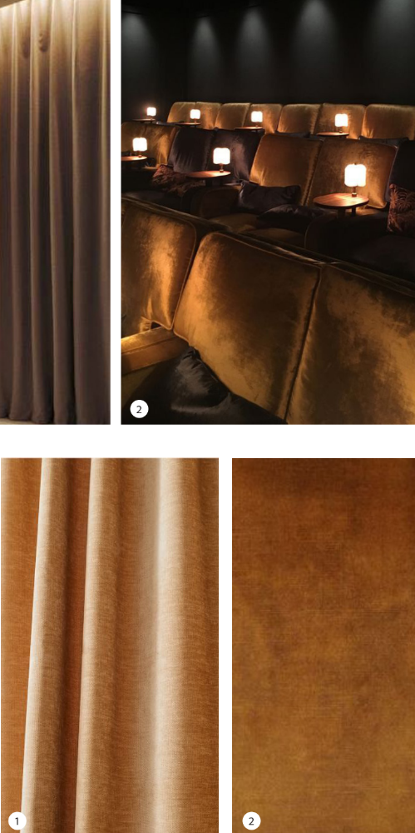
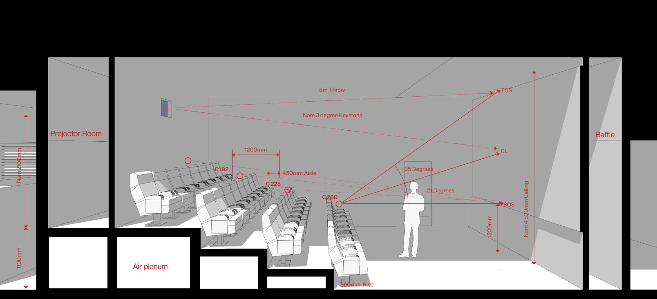
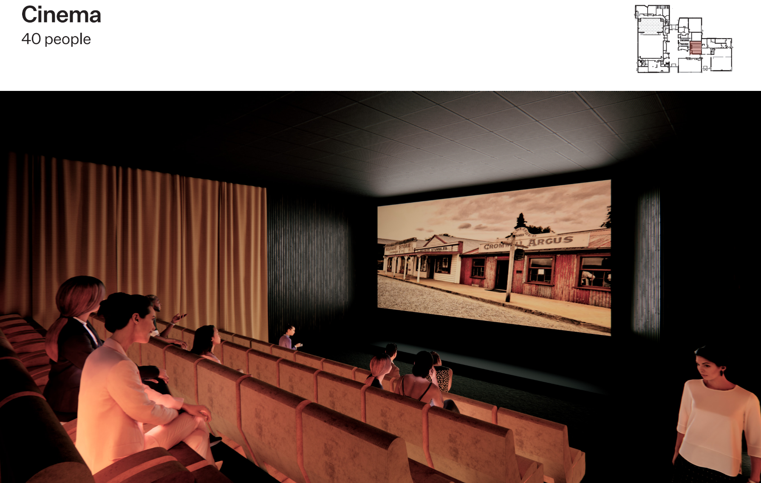
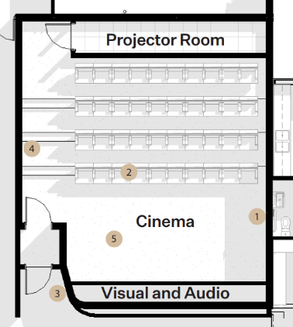
Cromwell Memorial Hall
Cinema Ideas

Slide 18
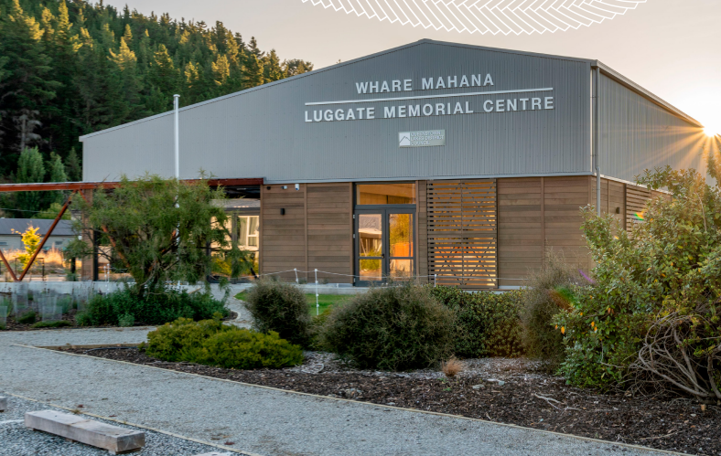
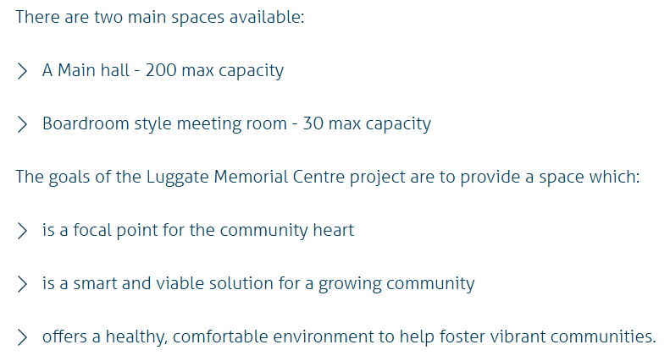
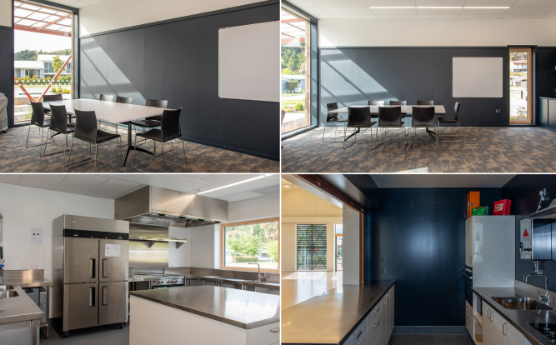
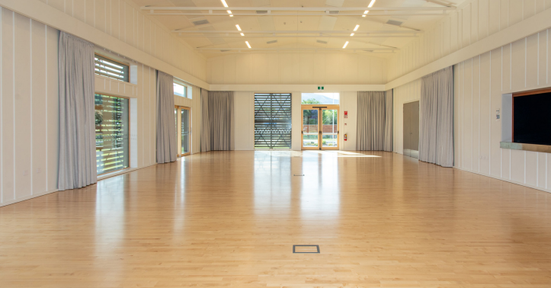
Recent Hall build
Luggate Memorial Centre – first passive community building in the Southern Hemisphere
Approx build price $5,000,000

Slide 19
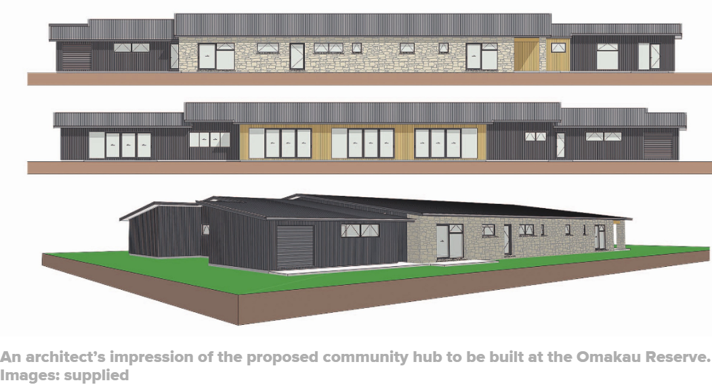
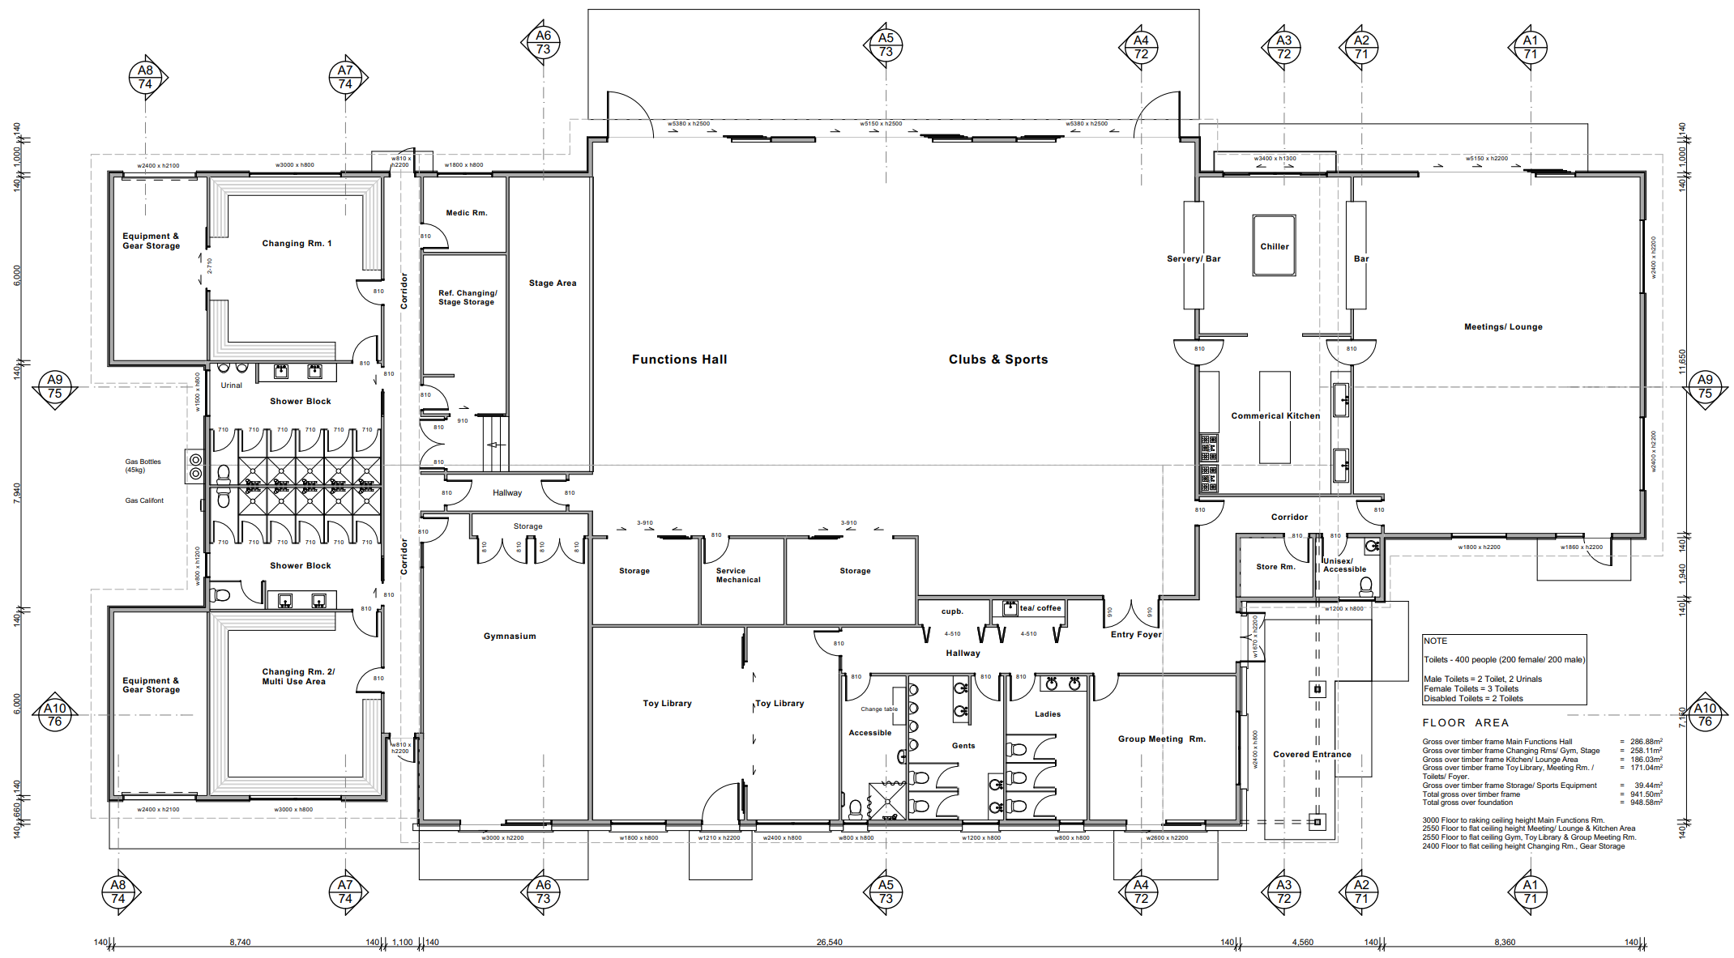
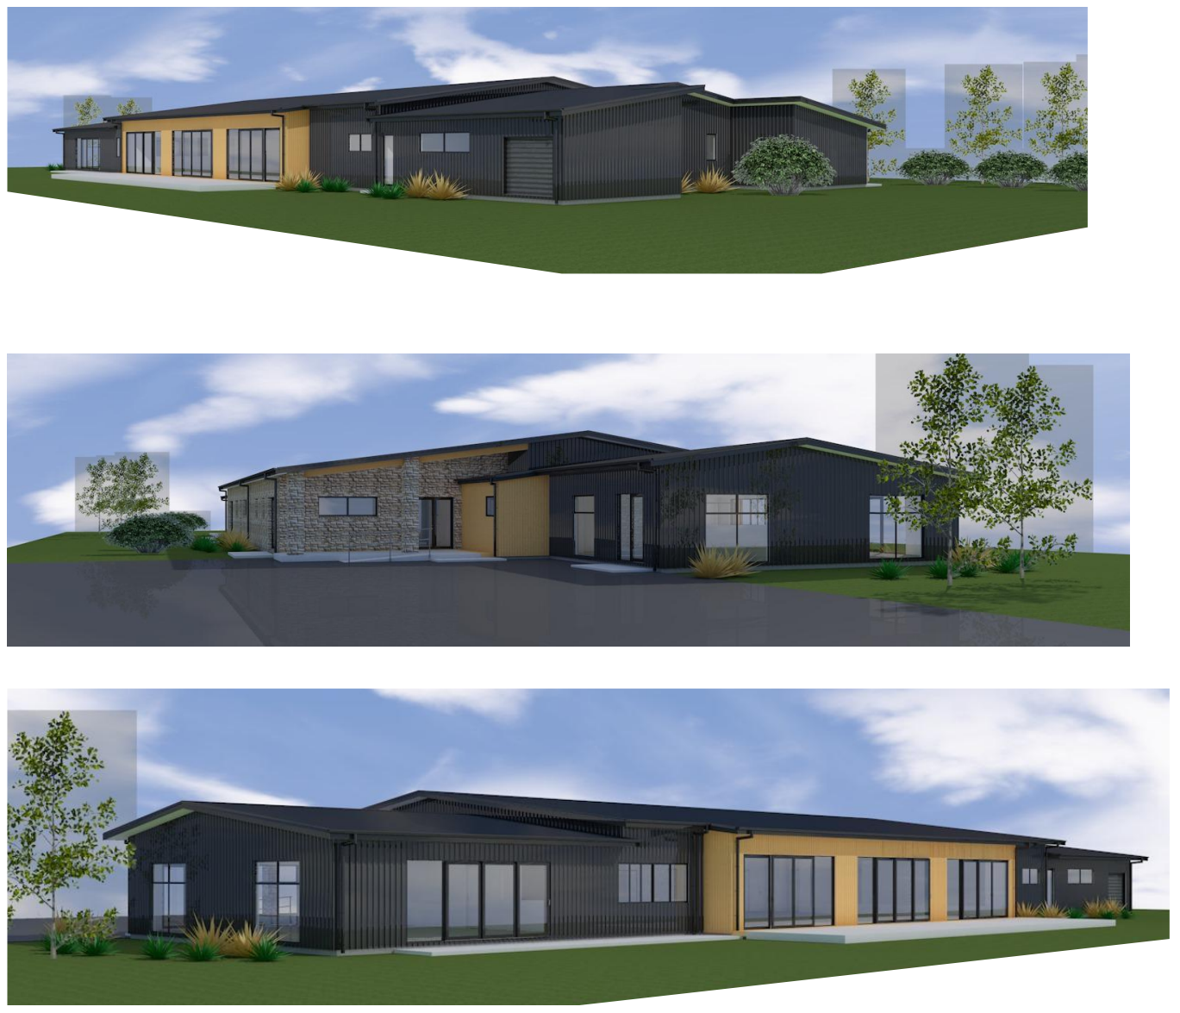
Manuherikia Community Hub
Indicative only

